Slide 1
SECURE DATA HIDING IN IMAGES USING STEGANOGRAPHY
CAPSTONE PROJECT
Presented By:
Student Name : SADUBUGGA LASYA
College Name & Department : Gokaraju Rangaraju Institute of Engineering and Technology AIML Department

Slide 2
OUTLINE
Problem Statement
Technology used
Wow factor
End users
Result
Conclusion
Git-hub Link
Future scope

Slide 3
Problem Statement
This project solves the problem of secure communication by hiding messages within images using steganography. It ensures that sensitive information remains undetectable and covert, protecting data from unauthorized access.

Slide 4
Technology used
This project uses python for implementation
Key libraries:
OpenCV for image manipulation
NumPy for handling data arrays
Platform used:
Python 3.x
Visual Studio Code

Slide 5
Wow factors
- High security and nearly undetectable messages.
- Seamless image processing with OpenCV.
- Potential for video steganography.

Slide 6
End users
- Cybersecurity professionals
- Government agencies
- Whistleblowers
- Organizations handling confidential data

Slide 7
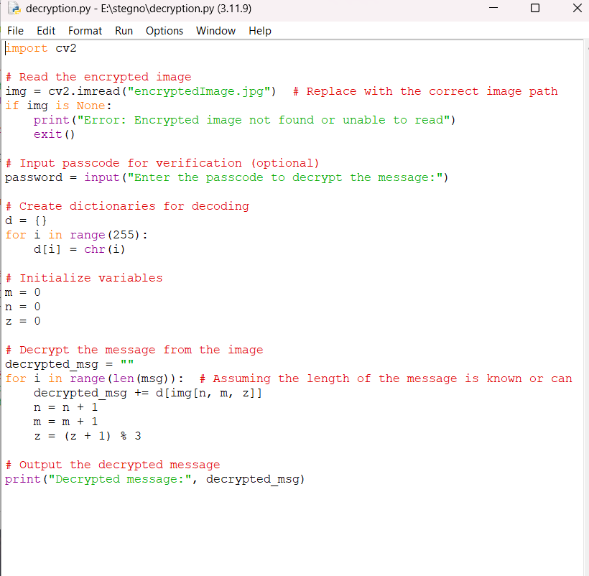
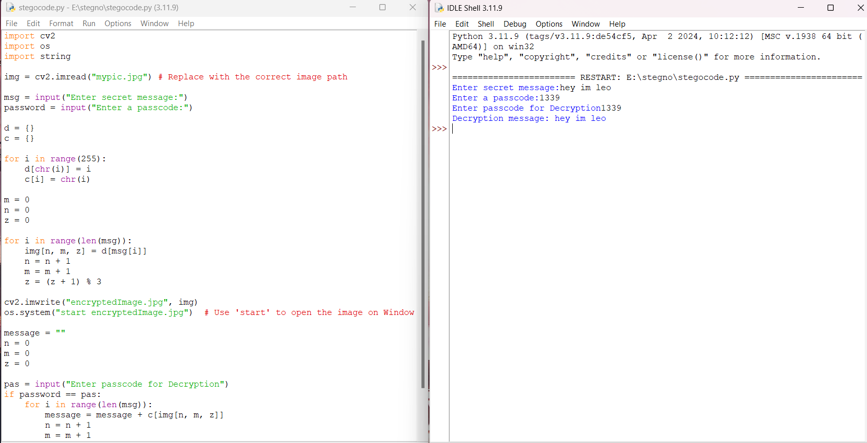
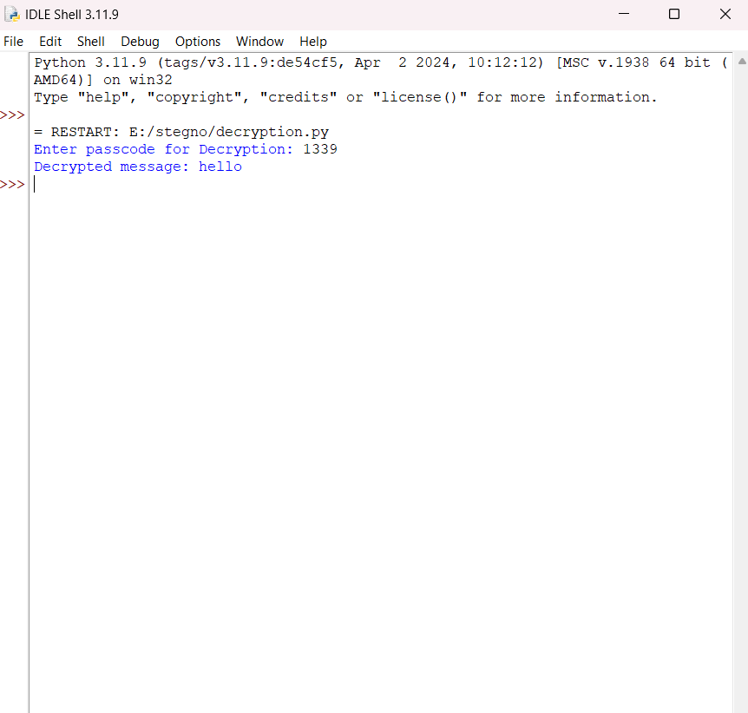
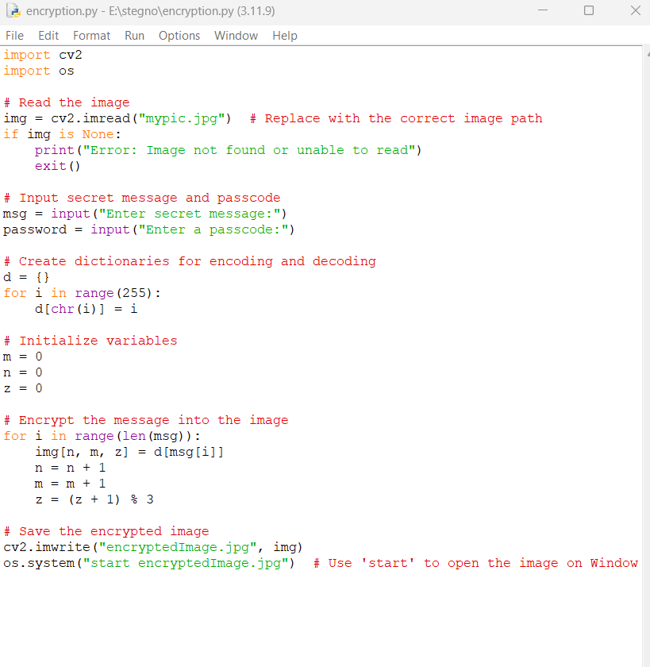
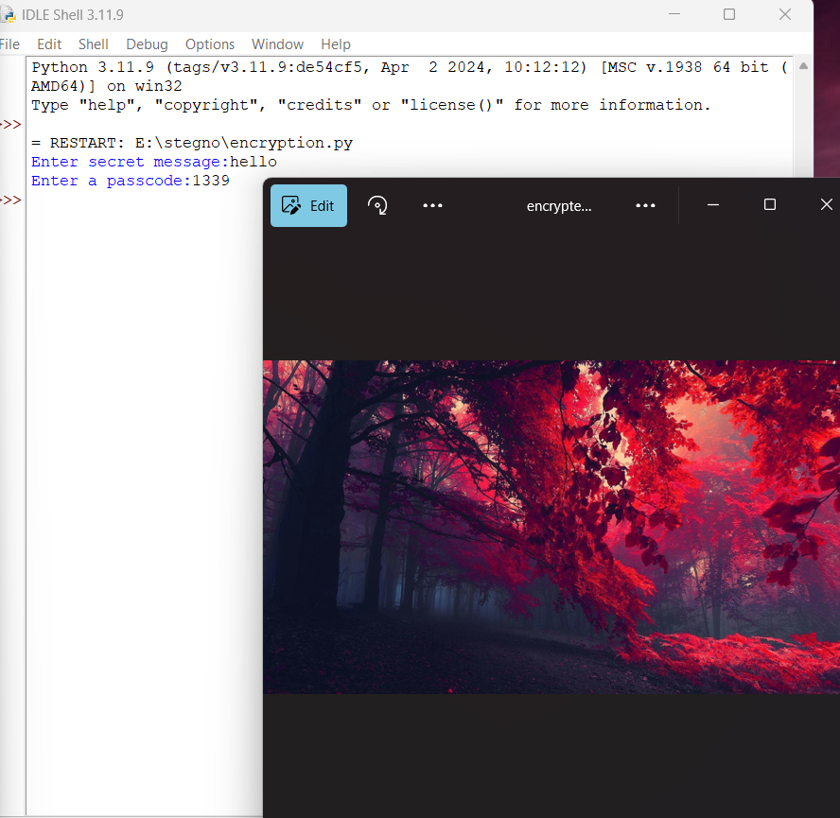
Results
decryption code
Stegonography code
encryption code

Slide 8
Conclusion
This project demonstrates secure message embedding within images using Python and OpenCV, making it a viable solution for confidential communication.
It also ensures that the hidden information remains undetectable to the human eye, preserving the integrity of the image while safeguarding the message.

Slide 9
GitHub Link
https://github.com/lasyasb/stegonography-ibm

Slide 10
Future scope(optional)
- Video and audio steganography
- AI-enhanced encryption techniques
- Mobile app integration for real-time usage.

Slide 11
THANK YOU

